Slide 1

BLOOD BANK MONITORING SYSTEM

Slide 2

BLOOD BANK MONITORING SYSTEM
Submitted by
M.MANO
J.NITHISH SYSTEM
S.SUBASH
REG.NO
22800072
22800078
22800096
Department of Computer Applications
Christ college of Engineering and Technology
Puducherry 605 010.

Slide 3
Under the guidance of
Internal Supervisor
Mrs. S. SHIRLEY, MCA.,
Assistant Professor
Department of Computer Applications
Christ College of Engineering & Technology,
Puducherry-605 110

Slide 4
abstract
The Main aim of the Blood Bank Management system is to ease the process of blood donation and allowance at the blood bank.
An Blood Bank Management System can be utilized in any centre, clinic, lab, or crisis circumstance which requires blood units for endurance.
The Online Blood Bank site is a true exertion of facilitating all cycles rotating around getting and giving blood.

Slide 5
PROJECT DESCRIPTION
Problem:

Slide 6
EXISTING SYSTEM
There are two types of process in the existing system: the blood donation process by donors, and the blood request process by hospitals. In both processes, an administrator is in charge of managing the blood inventory in the blood bank.
Blood Donation Process by Donors.

Slide 7
Disadvantage of existing system
At the present there is no software to keep any records in blood bank. It becomes difficult to provide any record immediately at times of emergency. Required more human efforts in maintaining the branch related information.

Slide 8
PROPOSED SYSTEM
The proposed system (Blood Bank Management System) is designed to help the Blood Bank administrator to meet the demand of Blood by sending and/or serving the request for Blood as and when required.
The proposed system gives the procedural approach of how to bridge the gap between Recipient, Donor, and Blood Bank

Slide 9
Proposed system Features
Efficient Blood Inventory Management.
Quick and Easy Access to Information.
Integration with Other Healthcare Systems etc.,

Slide 10
System specification
SOFTWARE REQUIREMENT: -
Front End :HTML,CSS,JAVASCRIPT
Operating System :WINDOWS 7,8,WINDOWS XP,MAC
Language :PYTHON
Application :VS CODE
Back End :MONGODB
HARDWARE REQUIREMENT: -
Processor :i5 to till
RAM :MIN 4 & MAX 8
Hard Disk Drive :512GB

Slide 11
MODULES
Home page
Login page
Registration Page
Blood Donor Registration Form
Contact us Page
Donor Request page
Donor list View page

Slide 12
(Modules Discription)
HOME PAGE :
“Save lives today! Visit our blood donation homepage and click 'Donate' to make a difference. Join us in our life-saving mission.”
LOGIN PAGE :
Ea "Easily donate blood! lAccess our donation platform via the login page. Join us in saving lives with just a click."donate blood! Access our donation platform via the login page. Join us in saving lives with just a click."

Slide 13

(Modules Discription)
REGISTER PAGE :
"Join our blood donation community! Register now and make a difference with our convenient donate button. Save lives today!“
DONOR FORM PAGE :
"Ready to donate? Fill out our donor form and click 'Donate' to save lives. Your contribution matters!”
CONTACT PAGE :
"Urgent blood needs? Submit a request on our blood request page. Help us meet critical demands. Every donation saves a life!"

Slide 14
(Modules Discription)
ADMIN PAGE :
"Manage blood donation operations efficiently. Access our admin page for streamlined control and oversight. Enhance blood donation initiatives with ease.“
DASHBOARD PAGE :
"Visualize blood donation data effectively. Navigate our dashboard page for insights, monitoring, and management. Empower your blood donation initiatives.“
BLOOD REQUEST PAGE :
"Efficiently manage blood requests with our admin page. Streamline operations and fulfill critical needs seamlessly."

Slide 15
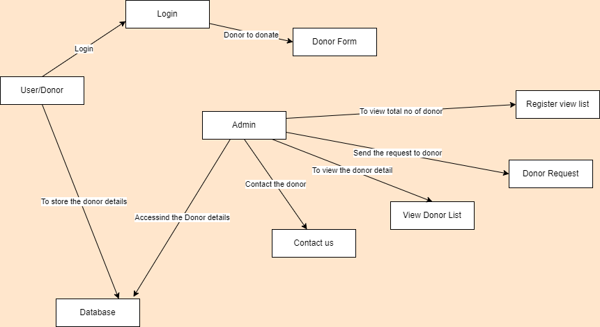
Overall data flow diagram

Slide 16

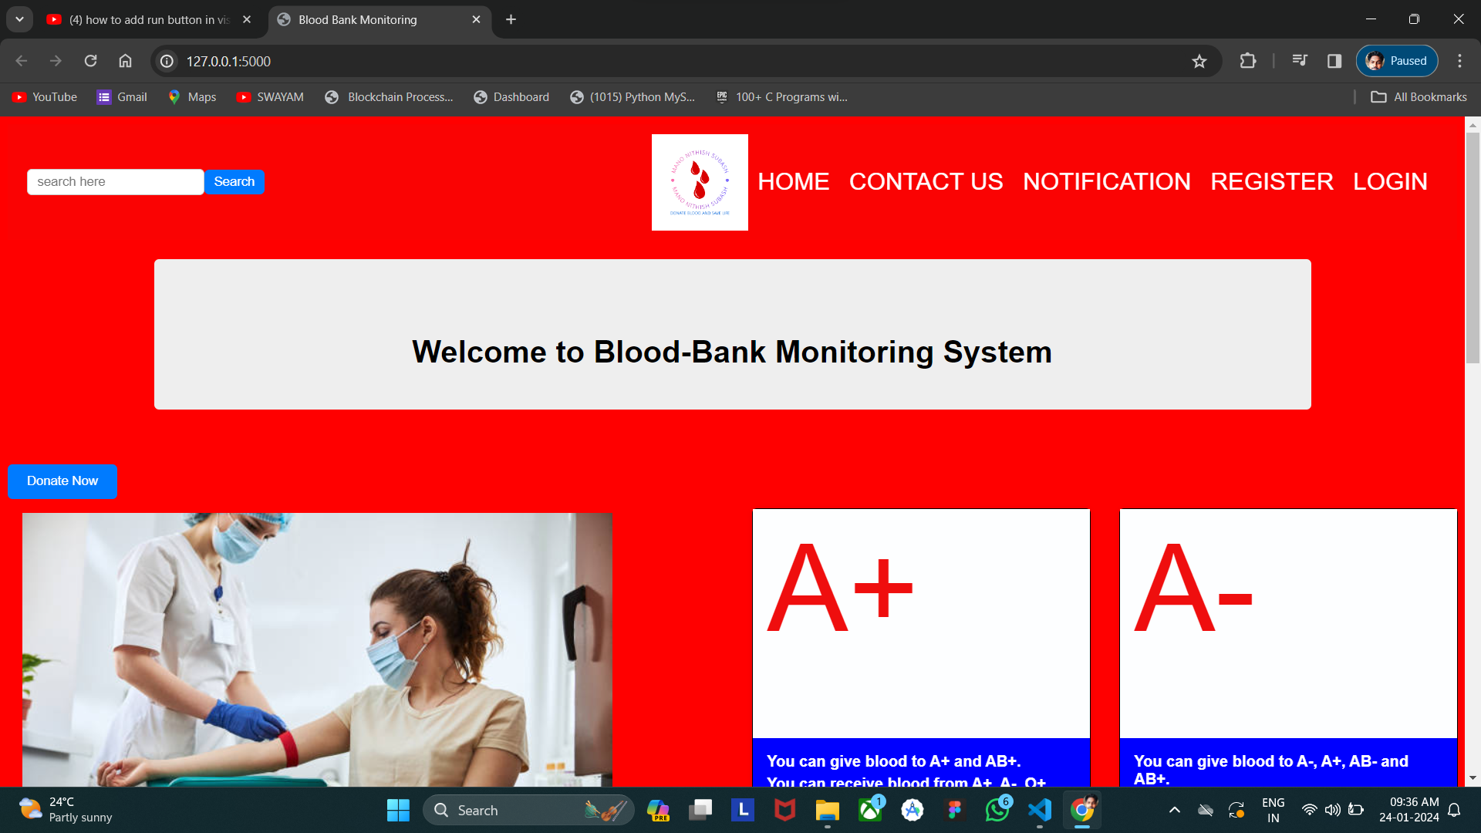
Description: HOME PAGE

Slide 17

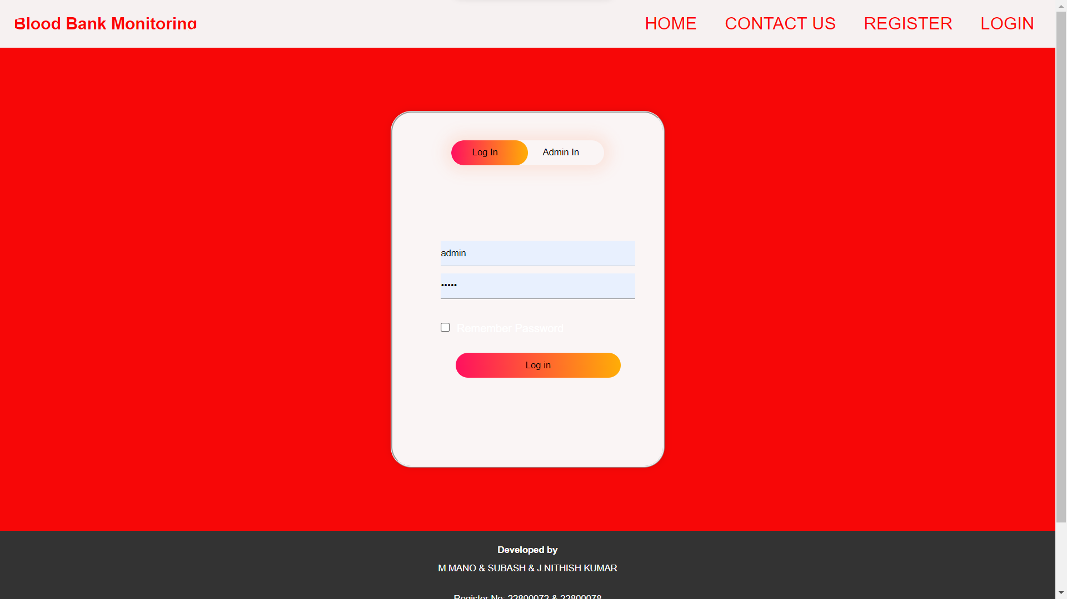
Description: LOGIN PAGE

Slide 18

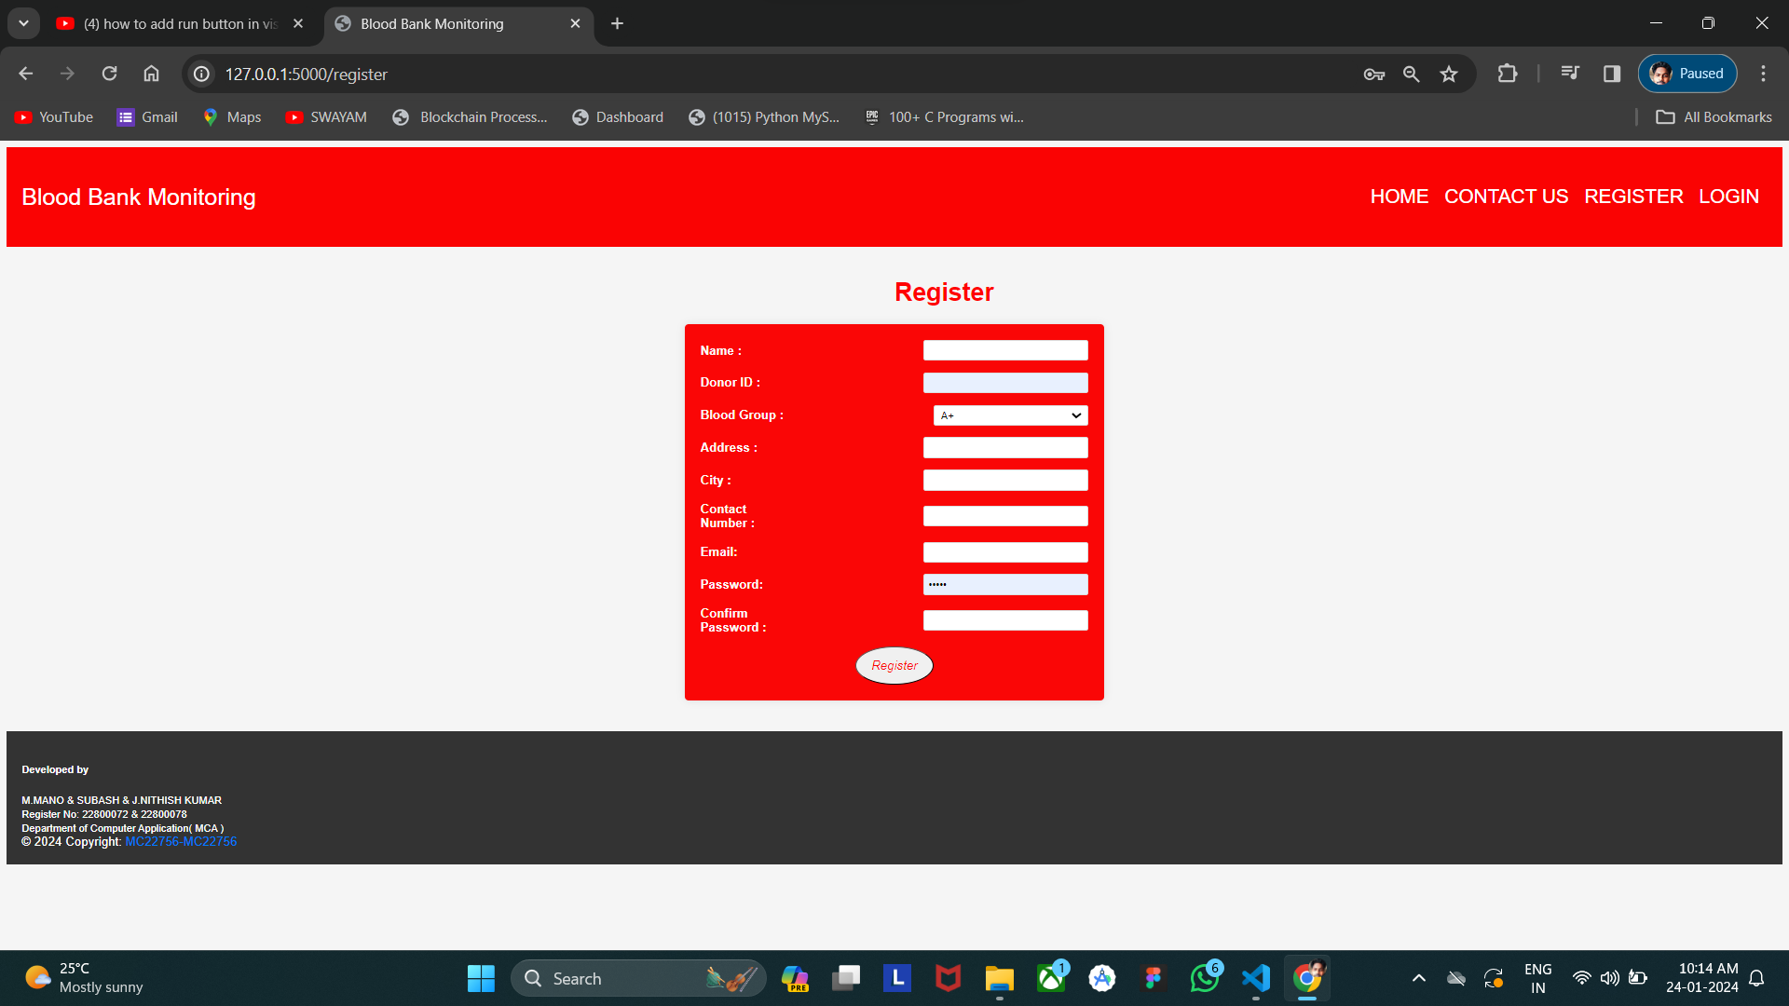
Description: REGISTER PAGE

Slide 19
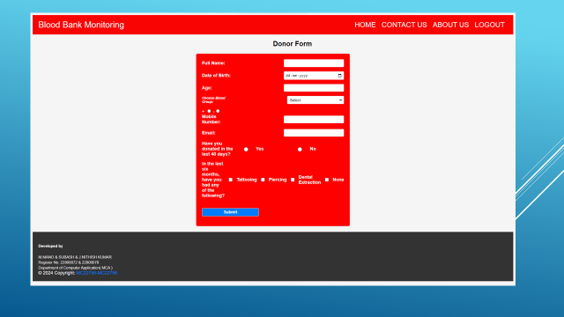
Description: DONOR PAGE

Slide 20
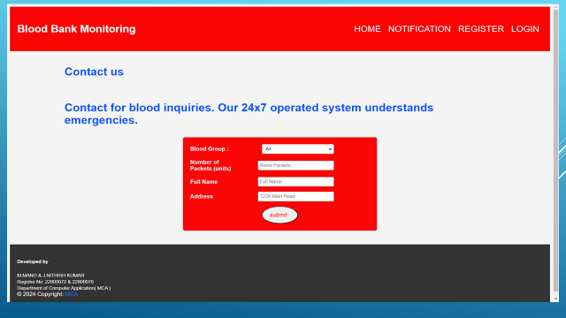
Description: CONTACT PAGE

Slide 21
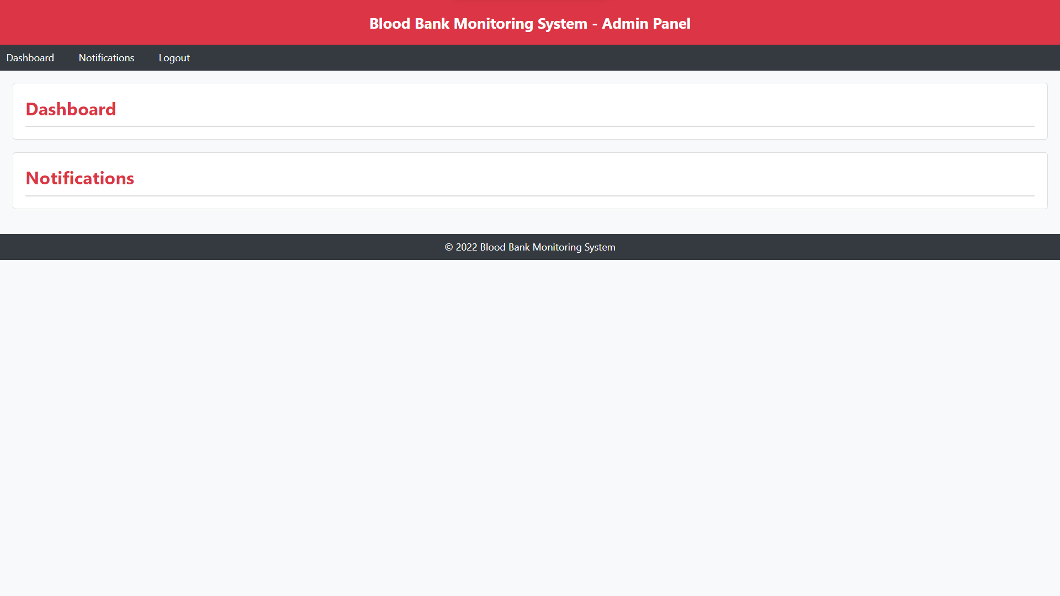
Description: ADMIN PAGE

Slide 22
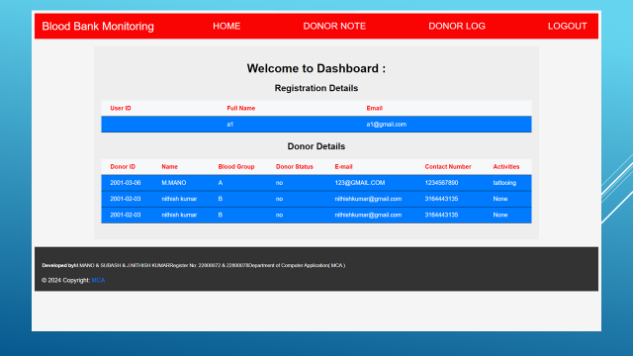
Description: DASHBOARD PAGE

Slide 23
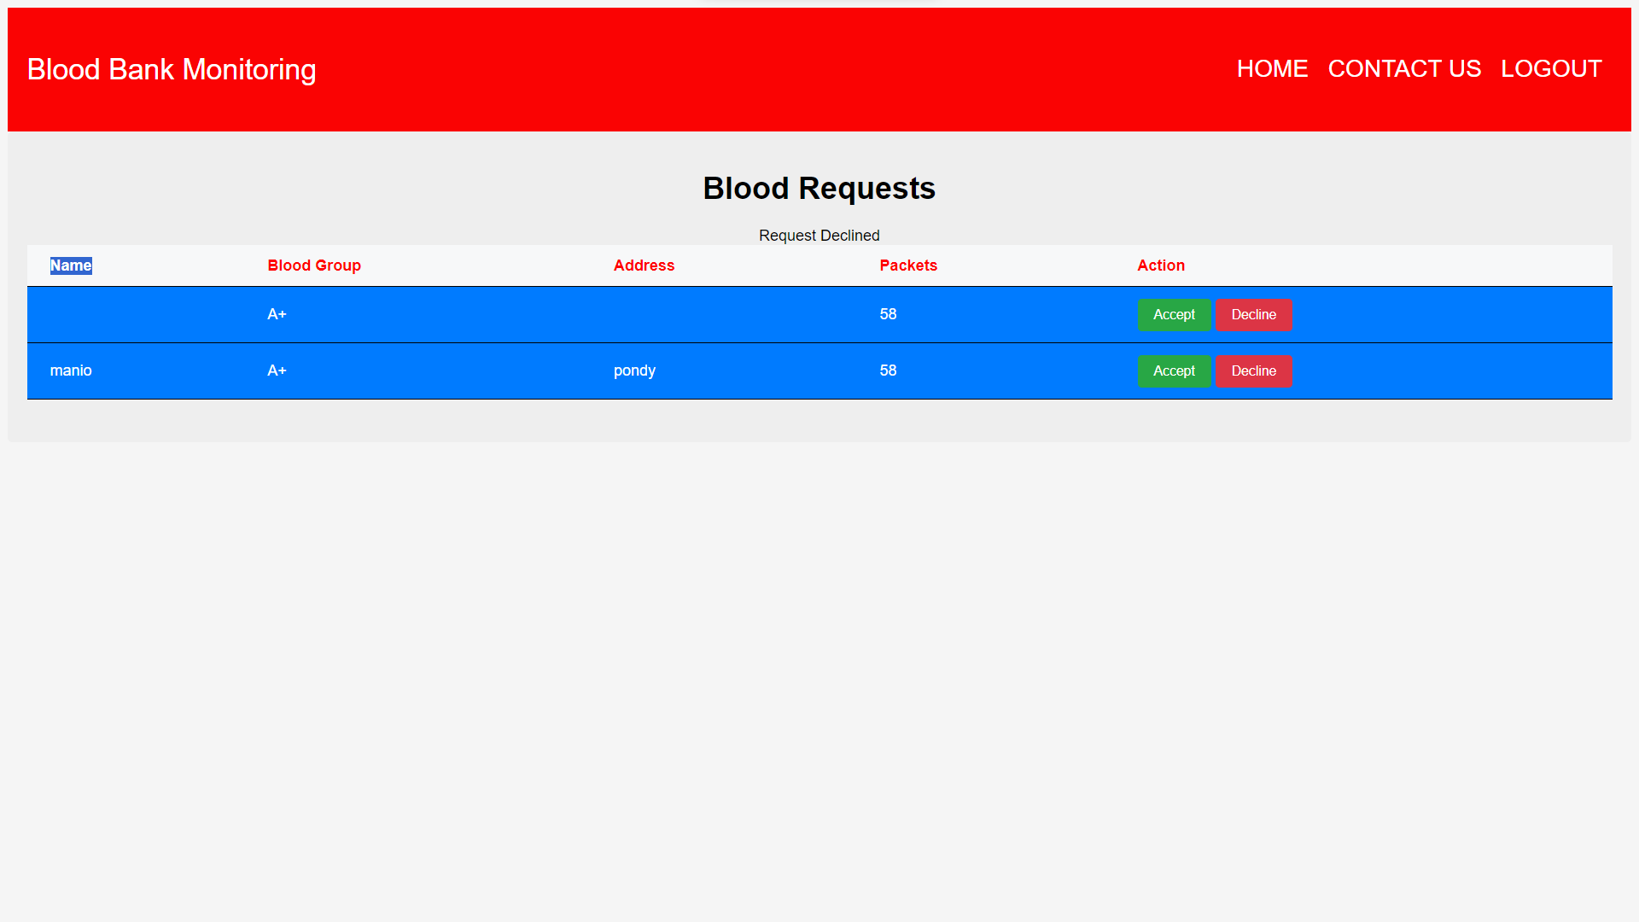
Description: BLOOD REQUEST PAGE

Slide 24
report
Project Title: BLOOD BANK MONITORING SYSTEM.
Introduction:
The Blood Donation Management System is a web-based platform designed to streamline the process of blood donation and management. It aims to facilitate the interaction between blood donors, recipients, and administrators, ensuring efficient blood collection, storage, and distribution.
2. Home Page:
The home page serves as the entry point to the system. It features a prominent "Donate" button, encouraging visitors to contribute to the noble cause of saving lives through blood donation.
3. Login Page:
Registered users can access their accounts through the login page. This authentication step ensures security and personalized interaction with the system.
4. Register Page:
New donors can sign up and register their details via the register page. This includes personal information, contact details, and relevant medical history, ensuring accurate donor records.
5. User Interface Page:
Once logged in, users are directed to the user interface page, where they can access various functionalities, including updating their profile, viewing donation history, and initiating blood requests.

Slide 25
report
Project Title: BLOOD BANK MONITORING SYSTEM.
6. Contact Page:
The contact page allows users to reach out for blood requests or inquiries. It provides a simple form for submitting requests, ensuring quick communication between donors and recipients.
7. Donor Form Page:
Prospective donors can fill out a donor form to register their willingness to donate blood. This form collects essential information needed for the donation process and ensures eligibility criteria are met.
8. Admin Page:
Administrators have access to the admin page, which serves as the control center of the system. Here, they can manage user accounts, oversee donation activities, and handle blood requests.
9. Dashboard Page:
The dashboard provides administrators with an overview of the system's performance and key metrics. It displays registered donor details, donation statistics, and pending blood requests.
10. Blood Request Page:
This page allows administrators to verify and process incoming blood requests. They can review requests, match them with suitable donors, and coordinate the blood collection and delivery process.

Slide 26
FUTURE ENHANCEMENT
Blockchain Integration:
Explore blockchain technology to enhance the traceability and transparency of blood products throughout the supply chain. This can improve security, reduce the risk of counterfeit products, and ensure compliance with regulatory requirements.
Mobile Application:
Develop a mobile application for donors to schedule appointments, receive notifications, and track their donation history. This can encourage regular donations and improve donor engagement.
Remote Monitoring:
Integrate IoT devices to remotely monitor blood storage conditions, such as temperature and humidity. Real-time alerts can be sent to staff in case of any deviations from opti.
Patient Blood Management (PBM):
Enhance the system to support PBM strategies aimed at optimizing the use of blood products, reducing transfusion rates, and improving patient outcomes.mal storage conditions, ensuring the quality and safety of blood products.

Slide 27
CONCLUSION
The Blood Bank Monitoring System offers a comprehensive solution to efficiently manage blood inventory, donation records, and distribution processes.
Through its user-friendly interface and robust features, it ensures the seamless coordination between donors, recipients, and healthcare providers, ultimately enhancing the accessibility and reliability of blood transfusion services.

Slide 28
BIBLIOGRAPHY:
Books:
Websites:

Slide 29
Thank you

